Slide 1
Animal Welfare
Name
Date

Slide 2
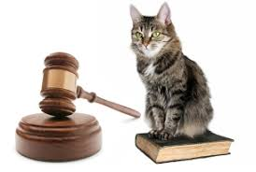
Introduction
The attention on conservation of animals, both domestic and wildlife, has been on the rise in the past two decades (Dubois et al. 2017).
There are a variety of critiques based on the value that either is for the support or are in opposing the practices of conservation and addressing the welfare of animals.
A few of those on both side of proponents and opponents are able to table data based on the animals.
Hence there is a scientific assessment to support any of the ideas raised.
Many studies have in the past provided experiential data on animal welfare, but the focus has been disproportionate in regard to certain practices (Hampton & Forsyth 2016).
Therefore the aspects of animal welfare should not show partiality but be all round in all aspects that involve all animals.

Slide 3
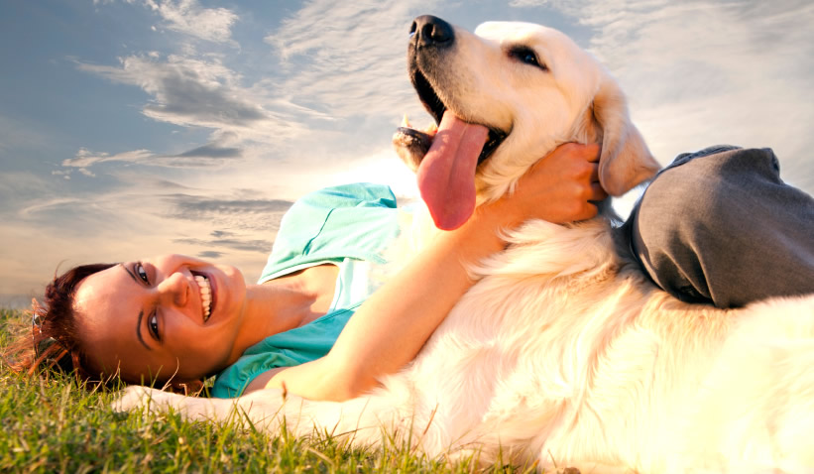
Animal Welfare Basics
What does it mean by ‘ Animal Welfare’?
The animal welfare means how well an animal can cope with all the conditions of the environment in which it lives, or it has been kept.
According to scientific evidence, an animal is in a favorable state of welfare. It has the ability and the freedom to express its behavior without any form of restriction.
Additionally, the animal should be in health, well-fed, no distress and not suffering from any unbearable or unpleasant states of pain or discomfort.
Favorable animal welfare calls for prevention of diseases and also offering of veterinary treatment to those under the distress of conditions.
Similarly, there should be appropriate management of their shelter, nutrition as well as handling by humans.
All these aspects of animal welfare are the responsibilities of every human where they should consider all the factors involved for proper handling of the animals.

Slide 4
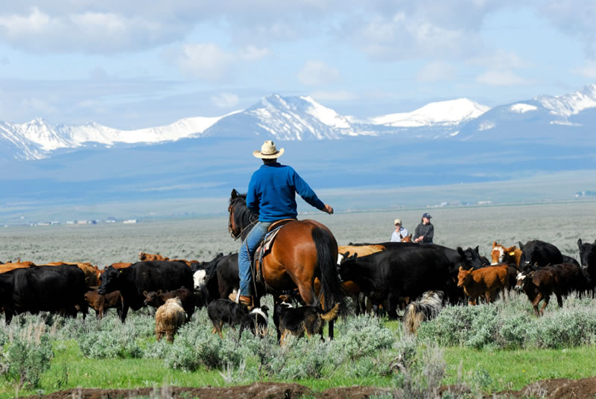
Principles of Animal Welfare
Many stakeholders are involved in the caring of animals such as farmers, trainers, veterinary, zookeepers, among others.
All the people involved in the caring of animals clearly understand the challenges and how to address them. Any program or business where animals are involved have policies on matters of the animal welfare to ensure that all the necessary care is given to the animals.
The policies comprise of practices like availing of proper food program which includes clean water, safe handling of the animals and safe environment.
There are also scrutiny measures where the animals are checked regularly on their health factors such as appetite, energy levels and other behavioral mechanisms.
There are other methods like scientific measuring tools such as the measure of cortisol levels in the blood which identifies the levels of stress. When all the evaluations test positive, and the animals are comfortable, the welfare is deemed favorable and acceptable.

Slide 5
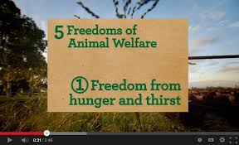
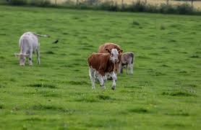
Five Freedoms
Animals have freedom of various aspects.
Freedom from Discomfort where the animals require to be provided with the appropriate environment for shelter and resting environment free from any discomfort.
Freedom from any form of thirst and hunger where proper diet should be availed accompanied with fresh water.
Freedom from fear and any form of distress. The animals’ environment should be free from any factors that may cause mental distress to the animal. Safety from pain, injuries or disease.
The animals should be protected from any factors that may cause injuries; hence they should always be done check-up to diagnose in case of any form of disease or body injuries.
Freedom to freely display their normal behavior where they should be provided with sufficient space in their facilities while with their companions.

Slide 6
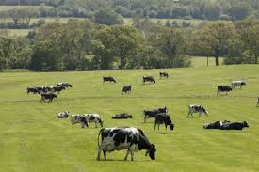
Benefits of Animal Welfare
The animal welfare management has its benefits across all the animals, both the domestic and the wild animals.
In livestock, the welfare of the animals increases productivity while improving the quality of meat for those that produce meat (Sinclair, Fryer, & Phillips, 2019).
The welfare also prevents harmful activities like poaching for financial gain.
In other cases, the animals are used wrongly for entertainment purposes against their freedom while making them distressful.
The welfare ensures that the animals enjoy all the freedoms such as proper diet, safe shelter, freedom from fear, pain or distress, among others.
Through the welfare, preservation of the ecosystem is easily managed.

Slide 7
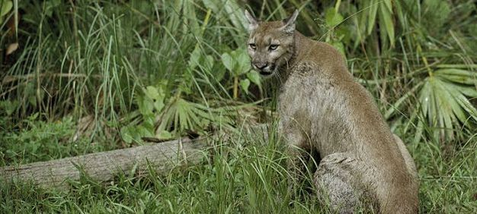
Wild Animals Welfare
The wildlife management and conservation have been a key focus following the expansion of human lands and freshwater areas coupled with climatic change impacts.
The conservation measures are important since from them policies can be easily formulated for the conservation of different wildlife habitats.
Wildlife has for long been an essential resource to all humans since through it there are various provisions such as food, leather, fur among others which are vital in human survival.
The wildlife is, therefore, a significant aspect of the economy and culture. Wild animals also are a source of entertainment in zoos, circuses and wild parks.
Conversely, wild animals can be threatening to human life since at times they can be a source of human diseases, and they can also destroy crops.

Slide 8
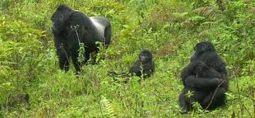
Wild Animals Welfare
Management critical to the debates on wildlife conservation.
Though there are debates in modern society about wildlife, there are values that have increasingly being emphasized.
The main focus is on the welfare where the wellbeing of every animal is important and valued.
Other significant concerns also involve the protection of some species in the animal population hence preserving the overall ecosystem in which the animals are part of the system.
In most cases, wild animals are left to care for themselves and live their lives without scrutiny (Gamborg et al. 2010).
Therefore concerns have been raised where the conservation includes not only the animals but also their habitats which have been threatened by the humans.
Active management of wildlife has been taken in the dimension controlling species.
The key critical questions are to consider what is there to protect and balancing the values such as nature protection.

Slide 9
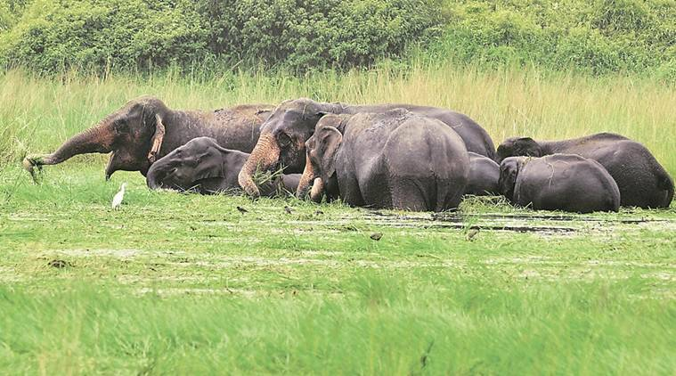
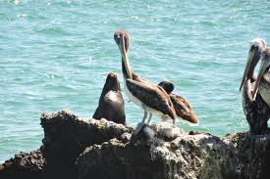
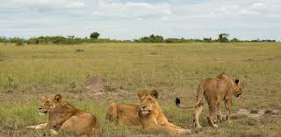
Values at stake in wildlife management
In the management of wildlife and the conservation measures, the two approaches are nature preservation and use of nature wisely. Both approaches do not support wildlife destruction.
When it comes to actually manage nature, the two approaches, however, differ in arguments.
The wise approach applies the use of wild nature as a source of food, raw materials for different timber industries and for recreation activities.
The approach appeals to the interests of most humans for a long time and is also called sustainable use approach.
The aim of the management is in enhancing and maintenance of the yield of nature which is a valued resource among humans.

Slide 10
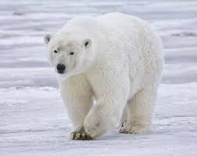
Preservationist Approach
The approach aims at protecting the undefiled nature and not use it. The approach also advocates for the rehabilitation of the damaged environment and nature through various interventions and projects.
The perspective also argues that the wild should be allowed to develop without interference from humans. Therefore it means the development is natural.
In case of recreation, there should be no trace left to prove that the place has been interfered with.
The value of resources has become an important aspect in the management of wildlife.
The values include ecological systems, species values and the importance of the welfare of animals.

Slide 11

Conclusion
In conclusion, therefore, animal welfare is an initiative that is paramount importance not only to the animals but also to the whole ecosystem.
The animal welfare consists of several domains such as food, shelter, health, behavioral aspects, environment and mental state.
There are principles that govern the animal welfare initiatives where the management is based on the approach of the wise nature and the preservationist approach.
The wildlife management is the critical aspect that requires keen focus by every human being since the domestic animals have the necessary care from the owners.

Slide 12
References
Dubois S, Fenwick N, Ryan EA, Baker L, Baker SE, Beausoleil NJ, Carter S, Cartwright B, Costa F, Draper C. (2017). International consensus principles for ethical wildlife control. Conservation Biology 31: 753– 760.
Gamborg, C., Gremmen, B., Christiansen, S. B., & Sandøe, P. (2010). De-domestication: ethics at the intersection of landscape restoration and animal welfare. Environmental Values, 57-78.
Hampton JO, Forsyth DM. (2016). An assessment of animal welfare for the culling of peri‐urban kangaroos. Wildlife Research 43: 261– 266.
Sinclair, M., Fryer, C., & Phillips, C. J. (2019). The benefits of improving animal welfare from the perspective of livestock stakeholders across Asia. Animals, 9(4), 123.

